Slide 1

VEHIRENT HUB
FINAL PROJECT PRESENTATION

Slide 2

OBJECTIVE
The problem that the car rental application aims to solve is facilitating the process of renting cars by providing a user-friendly platform for car owners to list their cars
The application streamlines the rental process, making it more convenient and efficient for both car owners and renters.

Slide 3
TOPICS COVERED
01
05
JavaFX
Collections
02
06
Class Definitions
List
03
07
Interface
Array List
04
08
Inheritance
JDBC Connection

Slide 4
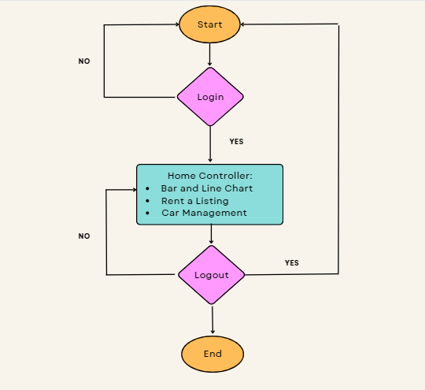
PROGRAM
WORK-FLOW

Slide 5

FEATURES
User- Friendly and Easy Application
Admin Login Functionality
System Admin CRUD functionality

Slide 6




TECH STACK
Java Developmen t Kit (JDK)
We have used the core technology to build the JAVA application along with JAVAFX
Eclipse (IDE)
Maven
Used Eclipse as an Integrated Development Environment to build the interactive application by writing the JAVA code
It serves as a primary build automation tool for Java Projects. It is used to manage dependencies and construct the application
JAVAFX SDK
MySQL
These libraries and tools furnishes the essential components for constructing JavaFX applications. This encompasses the JavaFX runtime, JavaFX APIs, as well as utilities such as javafxpackager and javafxdoc
MySQL is the open source relational database management system which is used with JavaFX to store and retrieve data from a database

Slide 7
TOOLS USED
01
05
GitHub Repository
MySQL Workbench
02
06
Trello (Task Management)
Microsoft Teams
03
07
Eclipse - IDE
Microsoft Powerpoint, Word(Documentation)
04
Scene Builder

Slide 8



CONTRIBUTION
UI Design was collaborated by every team member
Sparsh Ramchandani
Aseem Deshmukh
Aashay Pawar
Database Design and JDBC Connectivity
Dashboard Controller and its functionalities
Login Controller and its functionalities
Powerpoint Presentation and Report
Bar Chart and Line Chart
Admin Profile and its functionalities

Slide 9

THANK YOU!

